Slide 1

Note: The data and information in this document is reflective of a hypothetical situation and client. This document is to be used for KPMG Virtual Internship purposes only.
Sprocket Central Pty Ltd
Data analytics approach
Haseeb Ahmad

Slide 2
Note: The data and information in this document is reflective of a hypothetical situation and client. This document is to be used for KPMG Virtual Internship purposes only.
Agenda
Introduction
Data Exploration
Model Development
Interpretation

Slide 3
Note: The data and information in this document is reflective of a hypothetical situation and client. This document is to be used for KPMG Virtual Internship purposes only.
Introduction
Identify and recommend high value customers to target from the list of 1000 new customers.
Outline of problem
Sprocket Central is a company that specializes in high quality bikes and cycling accessories
Their marketing team is looking to boost business sales by analyzing provided datasets
Using the 3 datasets provided the aim is to analyze and view the trends in these datasets and then recommend high value customers from the list of 1000 new customers
This will be done with three phases of: Data Exploration, Model Development and Interpretation.
Contents of Data Analysis
‘Old’ and ‘New’ customer age distributions
Bike related purchases over the last 3 years by gender
Job industry distributions
Wealth segmentation by age category
Number of cars owned and not owned by state
RFM analysis and customer classification

Slide 4
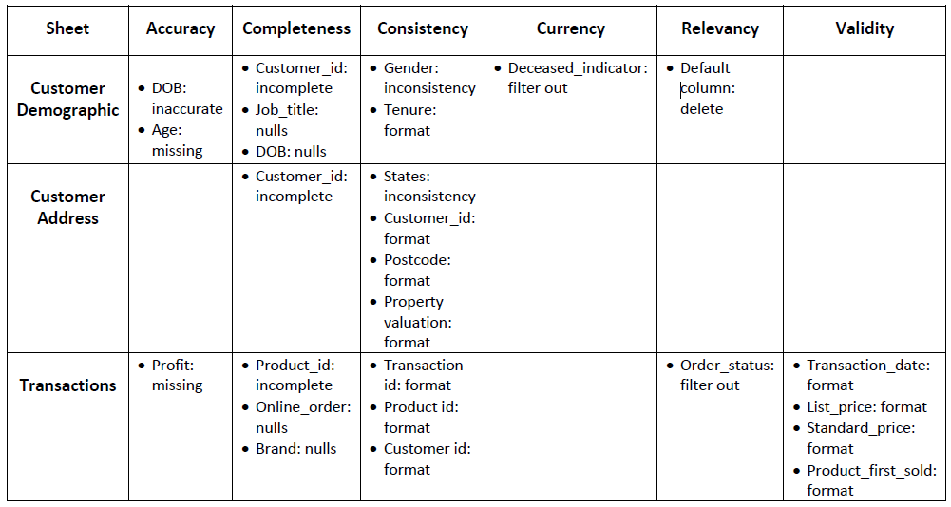
Note: The data and information in this document is reflective of a hypothetical situation and client. This document is to be used for KPMG Virtual Internship purposes only.
Data Exploration
Data Quality Assessment and ‘Clean Up’
Summary Table
Key issues for Data Quality Assessment
Accuracy: correct values
Completeness: data fields with values
Consistency: values free from contradiction
Currency: values up to date
Relevancy: data items with value meta-data
Validity: data containing allowable values
Uniqueness: records that are duplicated
An in-depth analysis has been sent via email.

Slide 5
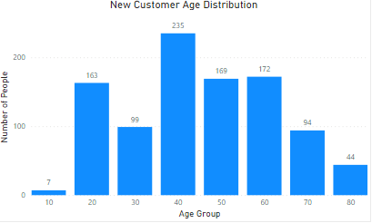
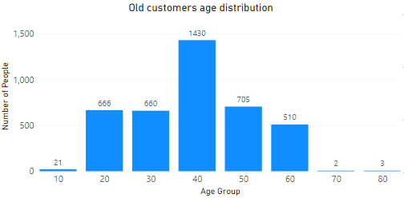
Note: The data and information in this document is reflective of a hypothetical situation and client. This document is to be used for KPMG Virtual Internship purposes only.
Data Exploration
‘New’ and ‘Old‘ customer age distributions
Most customers are aged between 40-49 in ‘New’. Similar trend could be seen in the ‘Old’ list
The lowest age groups are under 20 and above 80 for both ‘New’ and ‘Old’ customers lists
The ‘New’ customer list suggests that age groups 20-29 and 40-69 are most populated
The ‘Old’ customer list suggests age groups 20-69 are most populated with highest population in age group 40-59
There is a steep drop of customers in the age group 30-39 in ‘New’

Slide 6
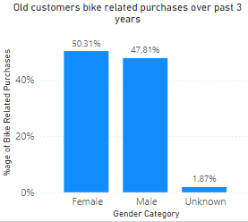
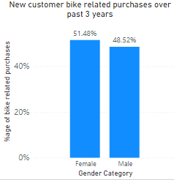
Note: The data and information in this document is reflective of a hypothetical situation and client. This document is to be used for KPMG Virtual Internship purposes only.
Data Exploration
Bike related purchases over last 3 years by gender
Over the last 3 years about 50% of bike related purchases were made by females, almost 48% by males and approximately 2% by unknown gender in ‘Old’ customers dataset
Females make up majority of bike related sales
Almost similar trend could be seen in the ‘New’ customer list except that we now do not have unknown gender.

Slide 7
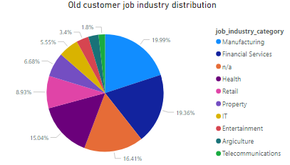
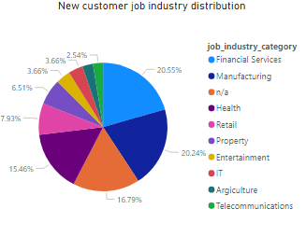
Note: The data and information in this document is reflective of a hypothetical situation and client. This document is to be used for KPMG Virtual Internship purposes only.
Data Exploration
Job Industry Distribution
Almost 20% of the ‘Old’ customers are in Manufacturing industry, followed by Financial services which is around 19%
The smallest percentage of customers are in Telecommunications industry for both ‘New’ and ‘Old’ customers i.e. 1.8% and 2.54% respectively
Similar trend could be seen for the ‘New’ customers but Financial services is having highest percentage around 20.5% followed by Manufacturing industry i.e. 20.24%

Slide 8
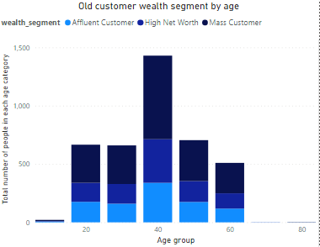
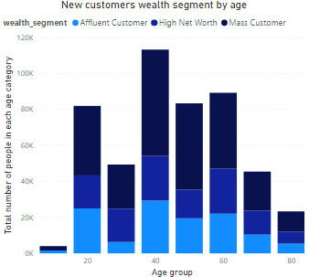
Note: The data and information in this document is reflective of a hypothetical situation and client. This document is to be used for KPMG Virtual Internship purposes only.
Data Exploration
Wealth segmentation by age category
In all age categories the largest number of customers are classified as ‘Mass Customer’
The next category is ‘High Net Worth’ customers
In some age groups ‘Affluent Customer’ can outperform ‘High Net Worth’ such as in the case of 20-29 and 40-49 age groups

Slide 9
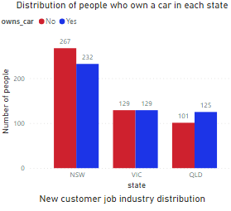
Note: The data and information in this document is reflective of a hypothetical situation and client. This document is to be used for KPMG Virtual Internship purposes only.
Data Exploration
Number of people who own a car and who don’t categorized by state
NSW has the largest amount of people that do not own a car. NSW seems to have a higher number of people from which the data was collected
Victoria is also split quite evenly. Both numbers are significantly lower than those of NSW
QLD has a relatively high number of customers that own a car

Slide 10
Note: The data and information in this document is reflective of a hypothetical situation and client. This document is to be used for KPMG Virtual Internship purposes only.
Model Development
RFM Analysis and Customer Classification
RFM analysis is used to determine which customers a business should target to increase its revenue and value.
The RFM (Recency, Frequency and Monetary) model classifies customer with different levels of engagement with business within these three categories
The customers who are more recent, purchase frequently and spend more money are high value customers

Slide 11
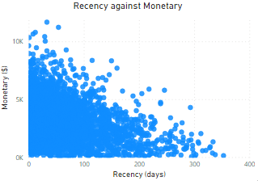
Note: The data and information in this document is reflective of a hypothetical situation and client. This document is to be used for KPMG Virtual Internship purposes only.
Model Development
Scatter plot based off RFM Analysis
This recency vs monetary graph shows that customers who purchased recently generated more revenue than customers who visited while ago
Customers from recent past (50-100 days) also show to generate a moderate amount of revenue
Those who visited more than 200 days ago generate low revenue

Slide 12
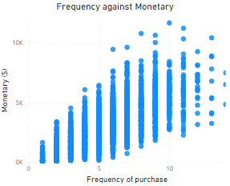
Note: The data and information in this document is reflective of a hypothetical situation and client. This document is to be used for KPMG Virtual Internship purposes only.
Model Development
Scatter plot based off RFM Analysis
Customer classified as “Platinum”, “very loyal” and “becoming loyal” visit frequently, which correlated with increased revenue for the business
Naturally, there is a positive relationship between frequency and monetary gain for the business

Slide 13
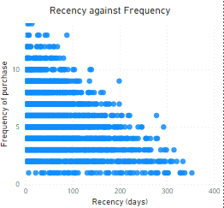
Note: The data and information in this document is reflective of a hypothetical situation and client. This document is to be used for KPMG Virtual Internship purposes only.
Model Development
Scatter plot based off RFM Analysis
Customers that visited recently have visited more frequently. Those visited within (0-50 days) have higher chance of visiting more frequently
Higher frequency has a negative relationship with recency values.

Slide 14
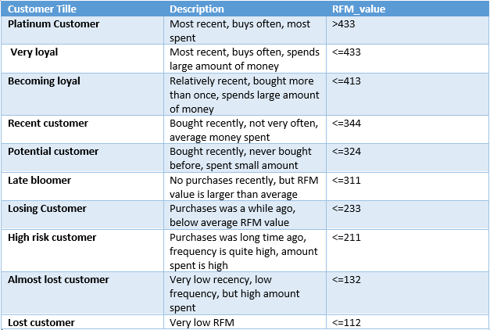
Note: The data and information in this document is reflective of a hypothetical situation and client. This document is to be used for KPMG Virtual Internship purposes only.
Model Development
Customer Title Definition list with RFM values assigned

Slide 15
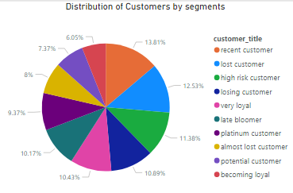
Note: The data and information in this document is reflective of a hypothetical situation and client. This document is to be used for KPMG Virtual Internship purposes only.
Model Development
Customer Title Distribution in dataset

Slide 16
Note: The data and information in this document is reflective of a hypothetical situation and client. This document is to be used for KPMG Virtual Internship purposes only.
Interpretation
Customer Target and Methodology
Most of the customers ae aged between (40-49) years so we should consider to target this age group more
Over the last three years, females have made slightly more bike related purchases as compared to males
Most of the customers belong to manufacturing and financial services industry
If we see in the wealth segment, most of the customers are classified as “Mass Customers” in all age categories
“NSW” is the state in which most of the customers do not own a car
We should target customers with high ‘RFM’ value, while seeing the statistics three of the customer segments “platinum customer”, “very loyal” and “almost loyal” are highly valuable for the company’s growth
Along with these customer segments we should also consider the above mentioned results to target the customers for marketing campaign as this could contribute to generate more revenue

